Slide 1

NEURULA
THE TENSORS
Nicolas Ayala^{PO}
Anish Pahilajani
Kat Negrete
Mahesh Vegiraju
Alex Hutchins
JUNE 1st, 2022
Notes:
NICO
We gotta adhere to this: https://piazza.com/class_profile/get_resource/l1a9bvmlfoa462/l3e1iuakvdi81

Slide 2
Introduction
We set out to create a website that made it easy for those interested in neural networks to explore.
Motivation = The complexity of machine learning can pose a barrier
Problem = Intimidating to get started.
Intended users = Students, people learning neural networks and those looking for a neural network playground.
Notes:
Mahesh
So our goal was to create a website that made it easy for people to explore neural nets. Our motivation for this goal is that there is a steep learning curve with learning neural nets, so we want to flatten that curve. And the intended users are students, people learning neural nets and those just wanting to mess with neural networks.

Slide 3
Achieved Goals
Single page website
Drag and drop functionality
Pytorch and Tensorflow code generation
Downloadable file of generated code
Ability to add a wide array of layers, activation, optimizers.
Notes:
Anish

Slide 4
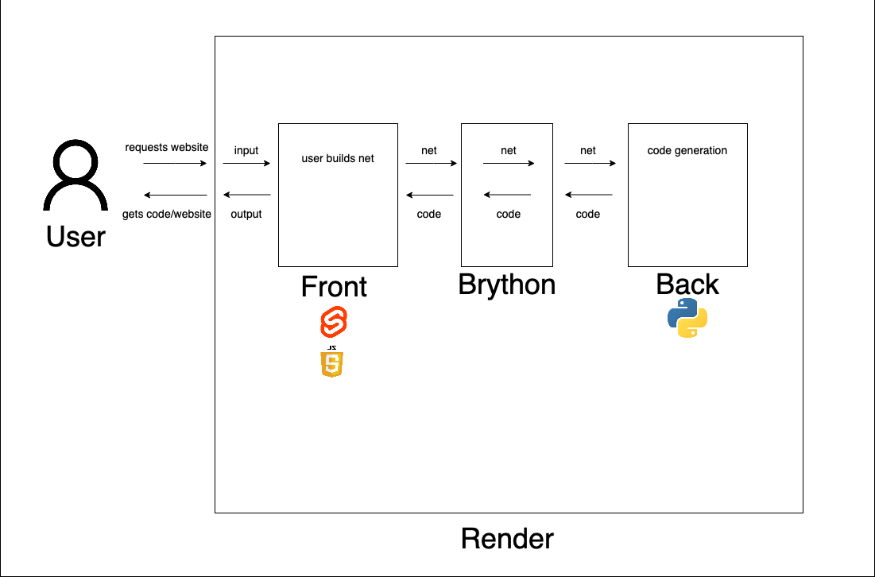
System overview and technologies used
Notes:
Mahesh:
So this is the system overview of how our project works. First the user requests for the website from render, our hosting provider. This gives the user the front end of the website. The front end is built using Svelte and JavaScript. From here the user can build their network and when they are ready they can generate the code for the net. This then uses Brython to send the net to the backend, which then sends it back to the user in the form of a python file.
SVELTE: Front-end, open-source JavaScript framework for making interactive webpages.
JAVASCRIPT: Programming language that is one of the core technologies of the World Wide Web, alongside HTML and CSS.
PYTHON: High-level, general-purpose programming language.
RENDER: Cloud application for web hosting.

Slide 5
Project Management
Scrum
We met three times a week after class, we updated each other on the progress we made on our user story.
We also met over zoom once a fortnight.
If we had any pending question we would dm each other on discord.
Notes:
Anish

Slide 6
Accomplishments & Challenges
Generating working Pytorch/ Tensorflow code for networks!
Finished sprints early or on-time!
Difficulty with technology spikes and ideas.
We did not have time to implement a solution to some problems in our backlog.
Adding ability for users to train ML model on cloud was too expensive
Notes:
Alex
One of our major accomplishments was creating something that could generate working Pytorch and Tensorflow code for user defined networks
We consistently completed tasks for each sprint early or on time meaning we had time to add additional features from the backlog.
For example: we were able to add additional layer types and premade neural networks.
However we struggled with learning and utilizing some technologies
For instance, we had to change web hosting platforms during a sprint since we couldn’t troubleshoot the technology issue fast enough.
We also had ideas that were theoretically easy to implement but difficult in practice.
This made it so we were unable to add certain features like user accounts to save networks or training their ML model on the cloud
Ideas that seemed initially easy were too hard to implement (non sequential networks, in-browser optimization).
Unable to give the user the experience of training their ML model on the cloud (since it was too expensive)
We had to change one of our technologies during a sprint since we couldn’t figure out how to host on Heroku (Switched to Render).
Ideas that seemed initially easy were too hard to implement (non sequential networks, in-browser optimization).
Expensive to get machine on cloud
Unable to add feature to save user created neural networks to an account

Slide 7

ENJOYED
We enjoyed creating a final product that were proud of.
We enjoyed learning and familiarizing ourselves with new technologies.
It was fun learning how to work in a group.
Gave us great experience for future projects/ career.
DIDN’T ENJOY
Daily Scrum meetings after an early morning class were hard to attend.
It was also hard learning how to work in a group.
Coordinating everyone’s schedules and availability was difficult.
Notes:
Alex
As for things that we enjoyed about this project:
Creating a final product that we’re all proud of was satisfying
Overall it felt like we learned a lot by working with people in a group setting as well as with new technologies.
This project was also a great experience for us to show to future employers and to base new projects off
For things we didn’t enjoy:
Waking up early and meeting was difficult for even the average college student
It was also new to a lot of us for working in a group for a project of this magnitude, especially when we had to coordinate 5 different schedules and availabilities.

Slide 8
Lesson we learned
What Worked
Transparency when communicating
Communicate about roadblocks
Scheduling when to meet
Planning out goals each Sprint
What Didn’t Work
Ghosting your Team
Keeping roadblocks to yourself
Not planning when to meet
Picking random goals each Sprint
Notes:
Kat

Slide 9
And now for a live demo of Neurula
Notes:
NICO: Live Demo

Slide 10
Thank you !
Feel free to play around with our project:
https://neurula.onrender.com

Slide 11
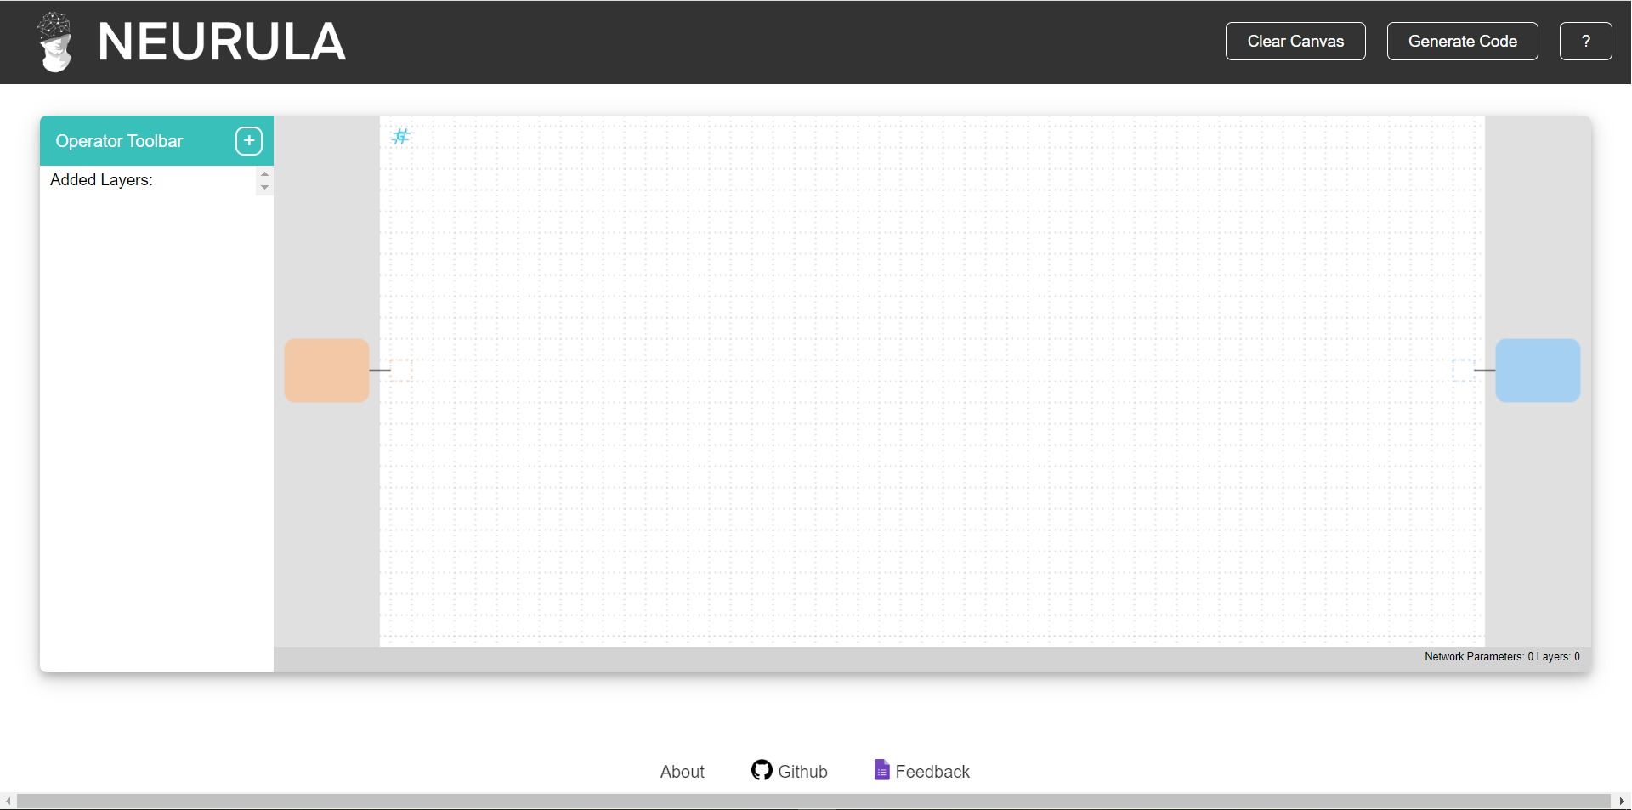

Slide 12
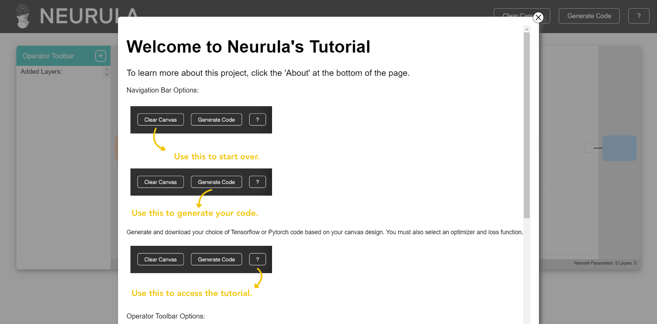

Slide 13
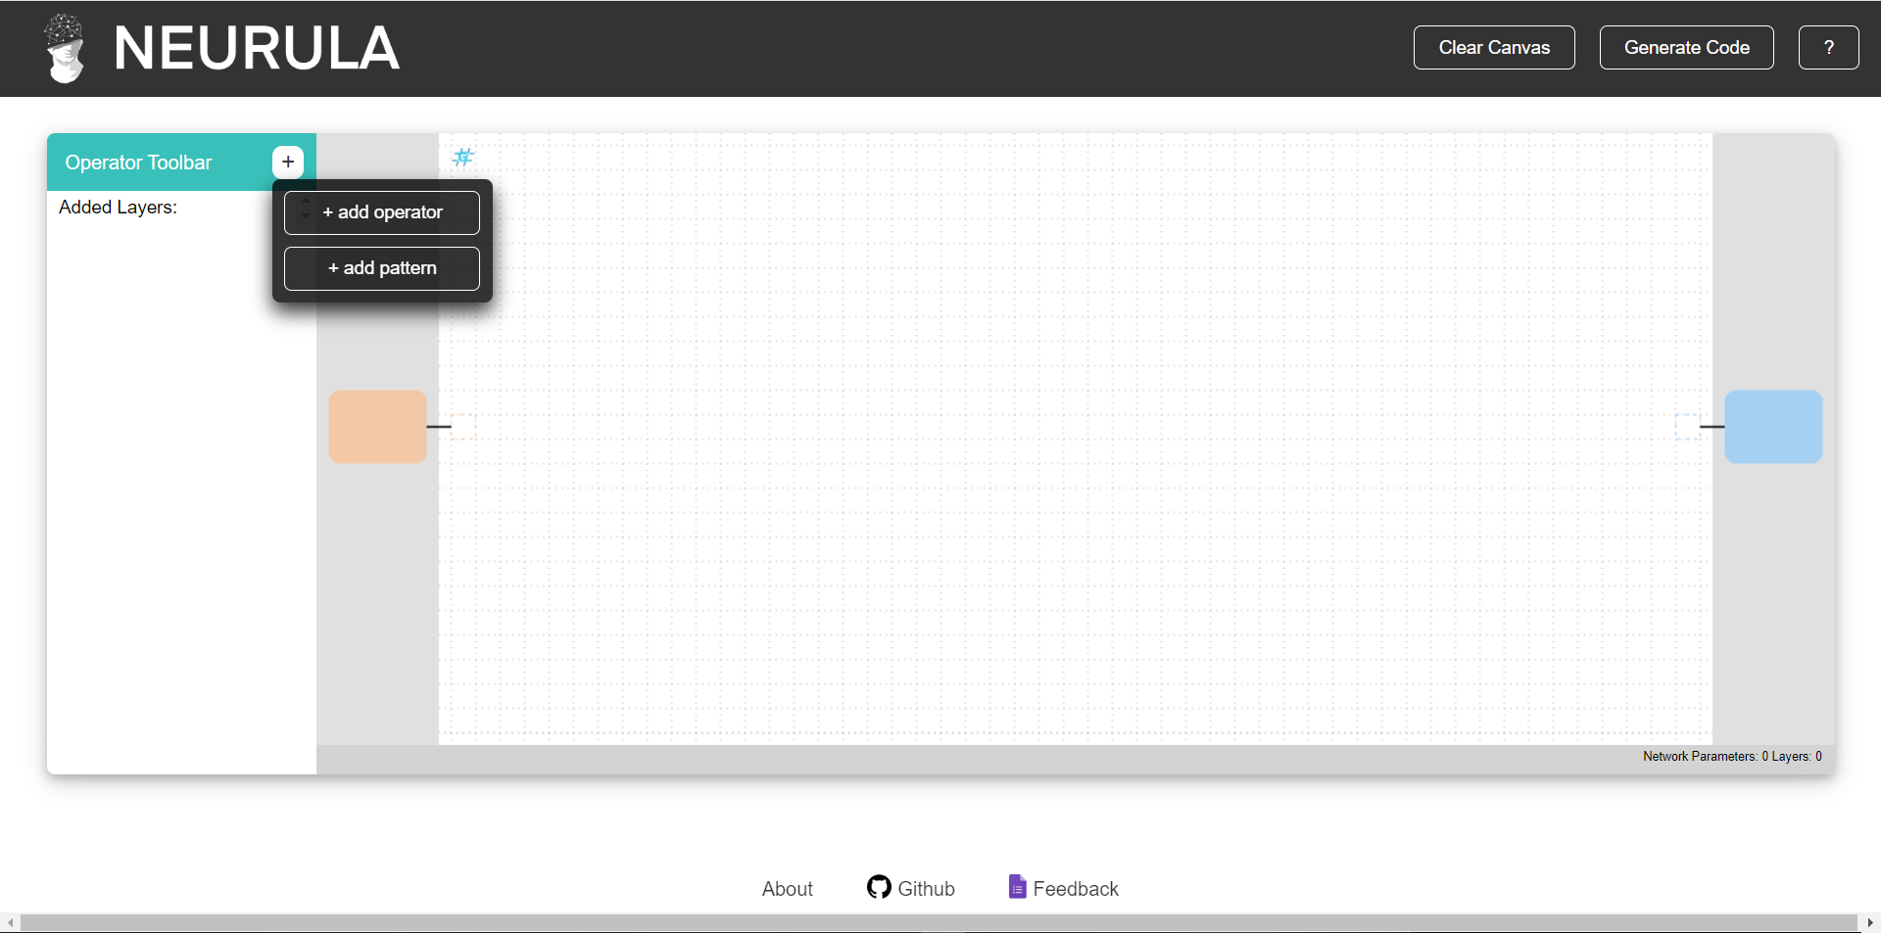

Slide 14
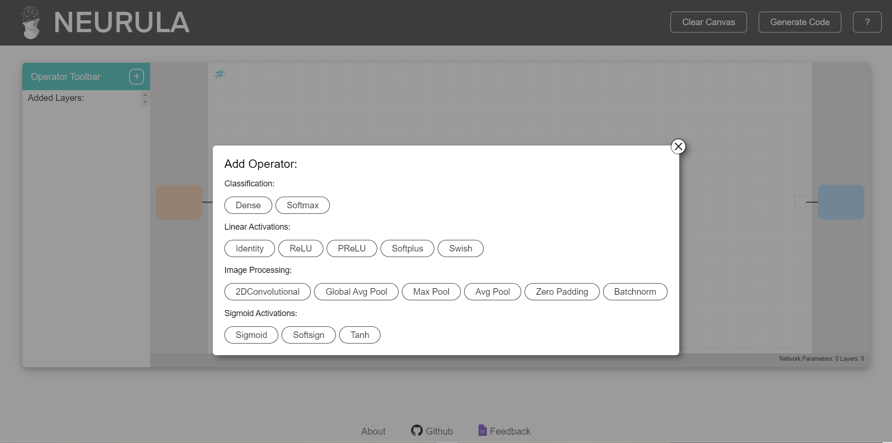

Slide 15
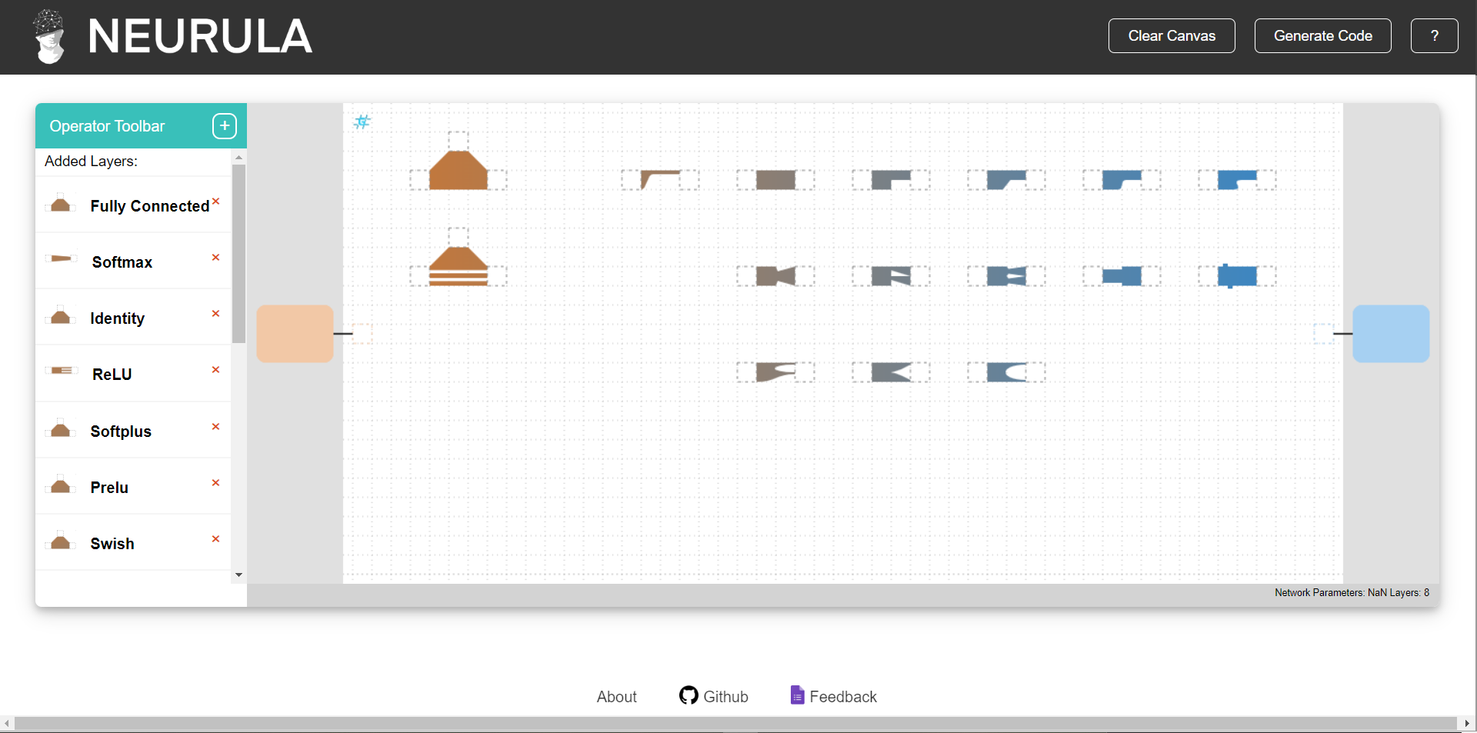

Slide 16
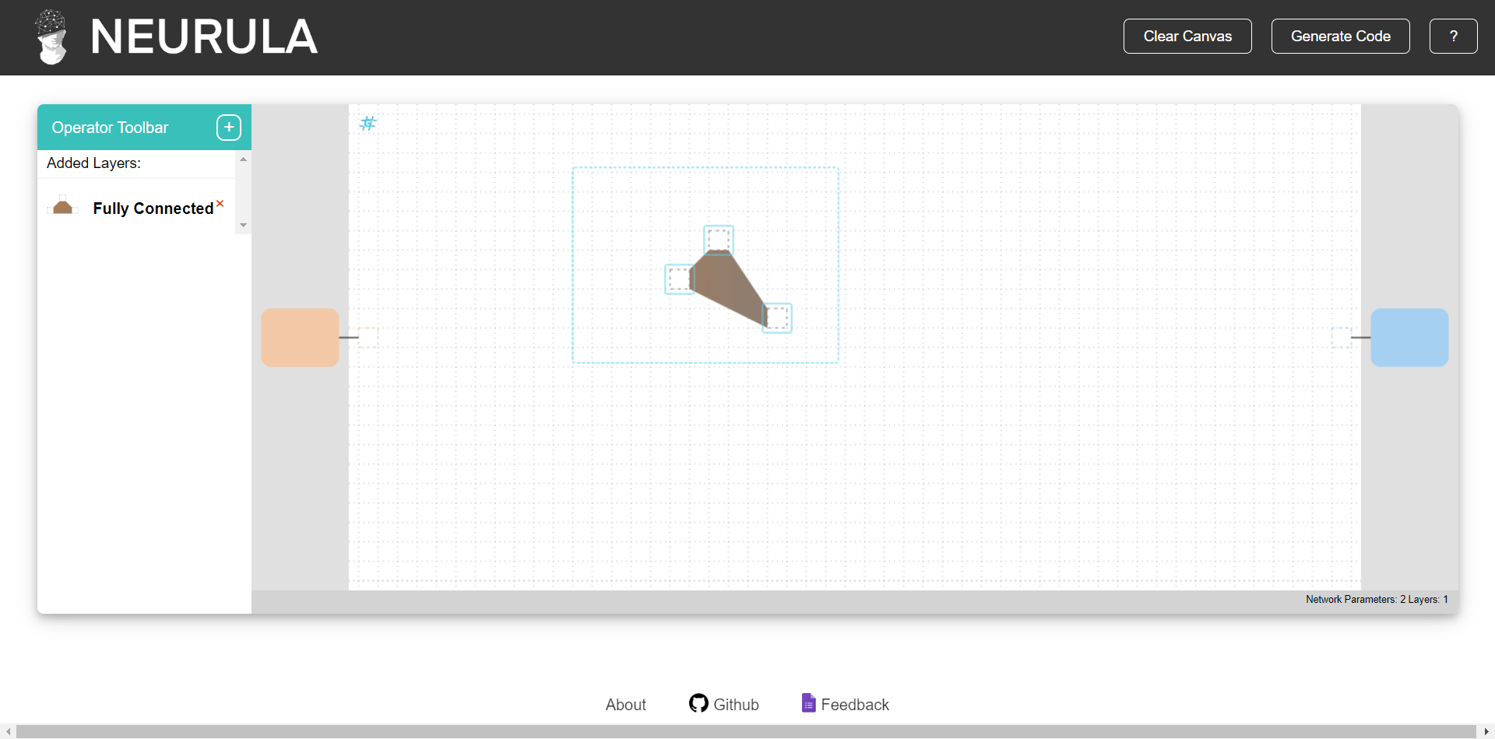

Slide 17
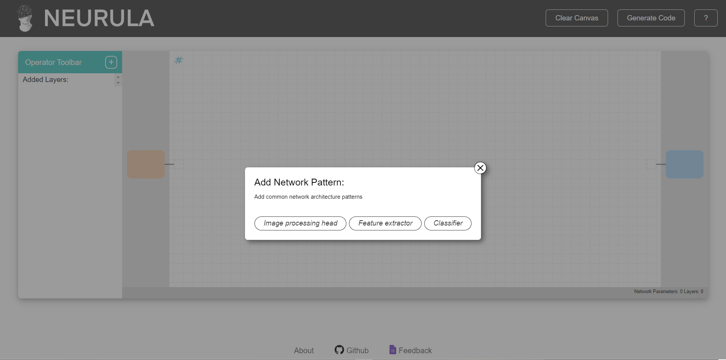

Slide 18
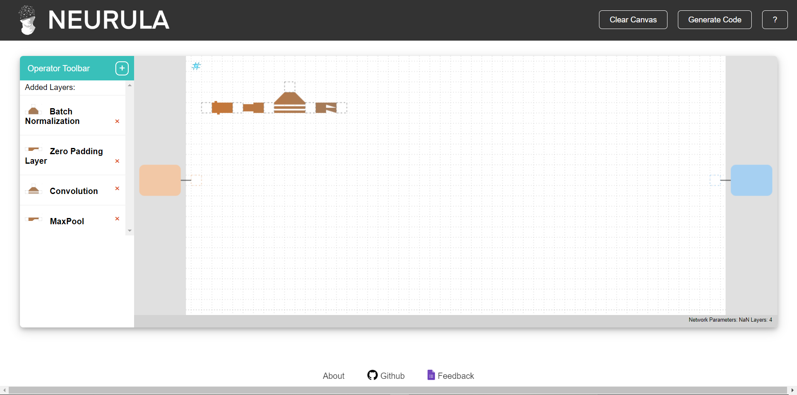

Slide 19
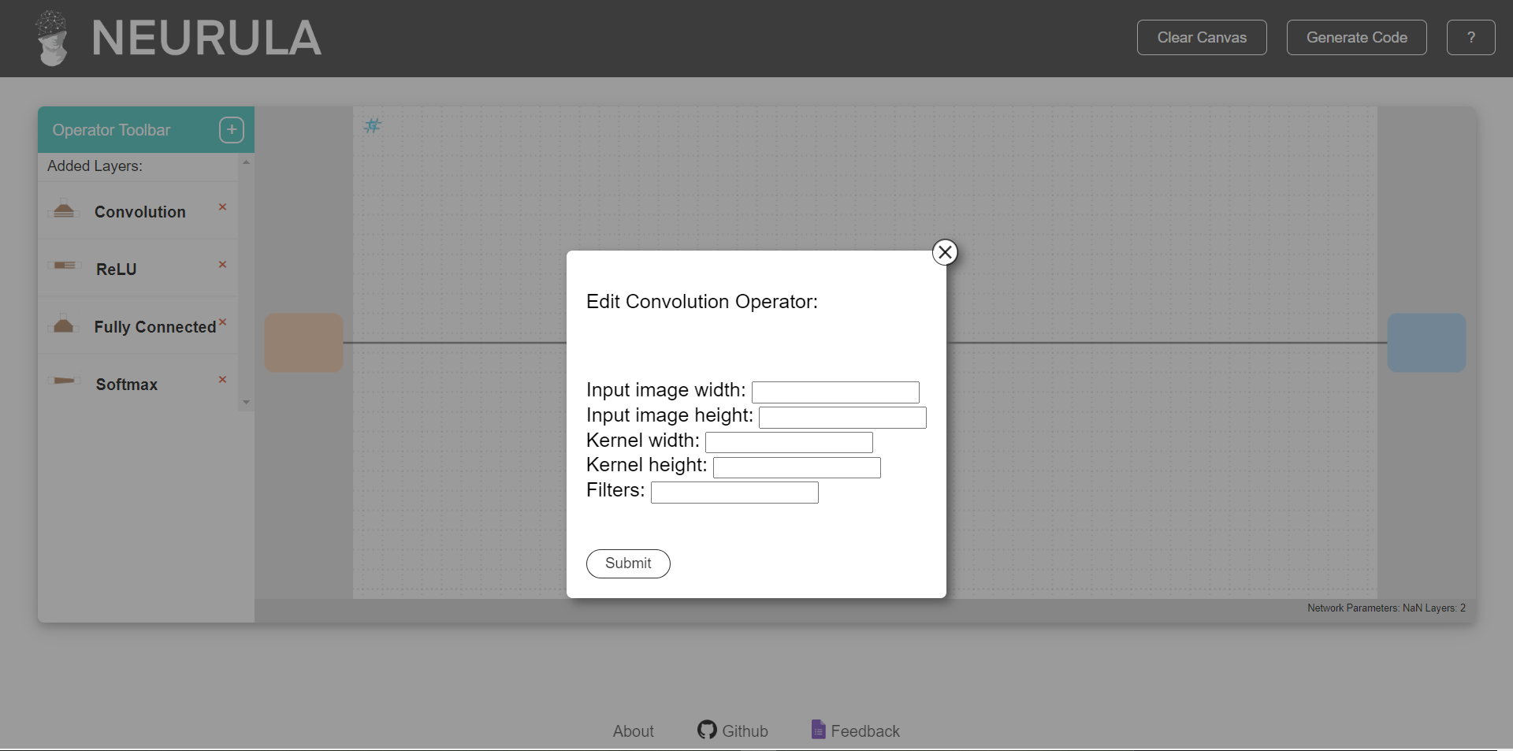

Slide 20
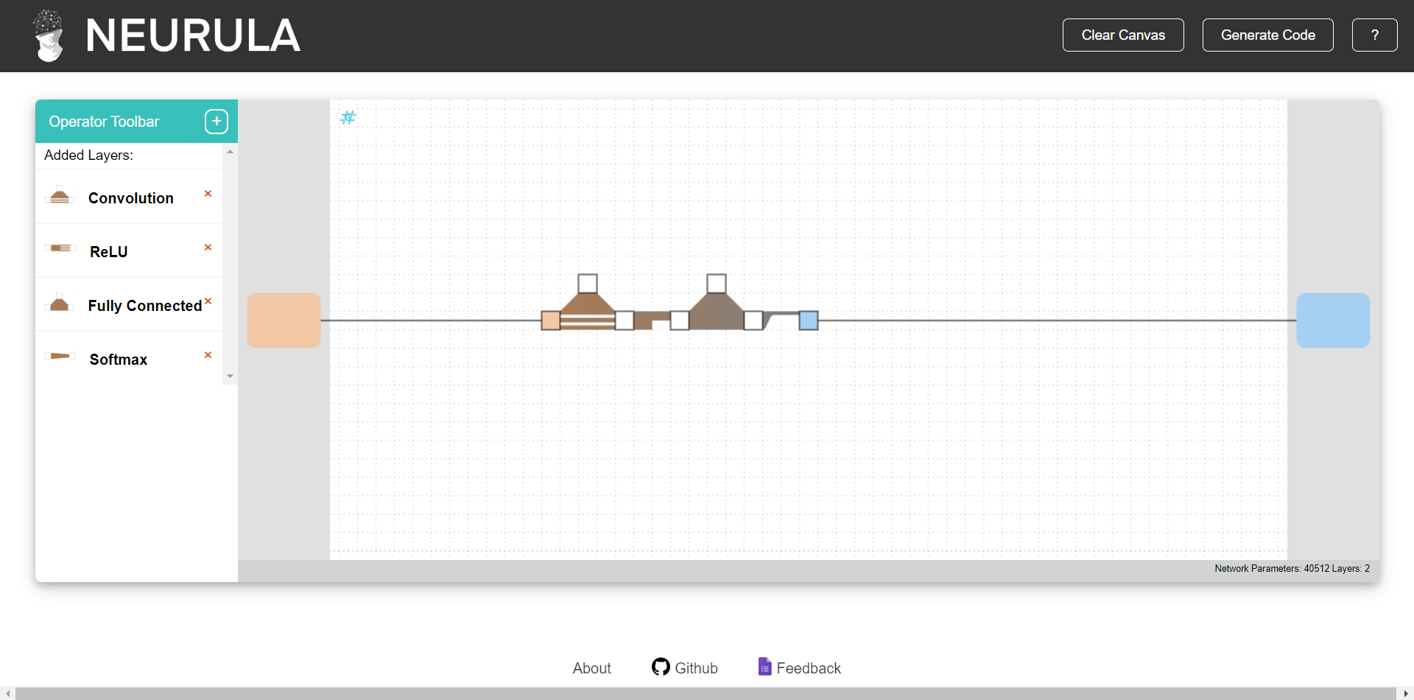

Slide 21
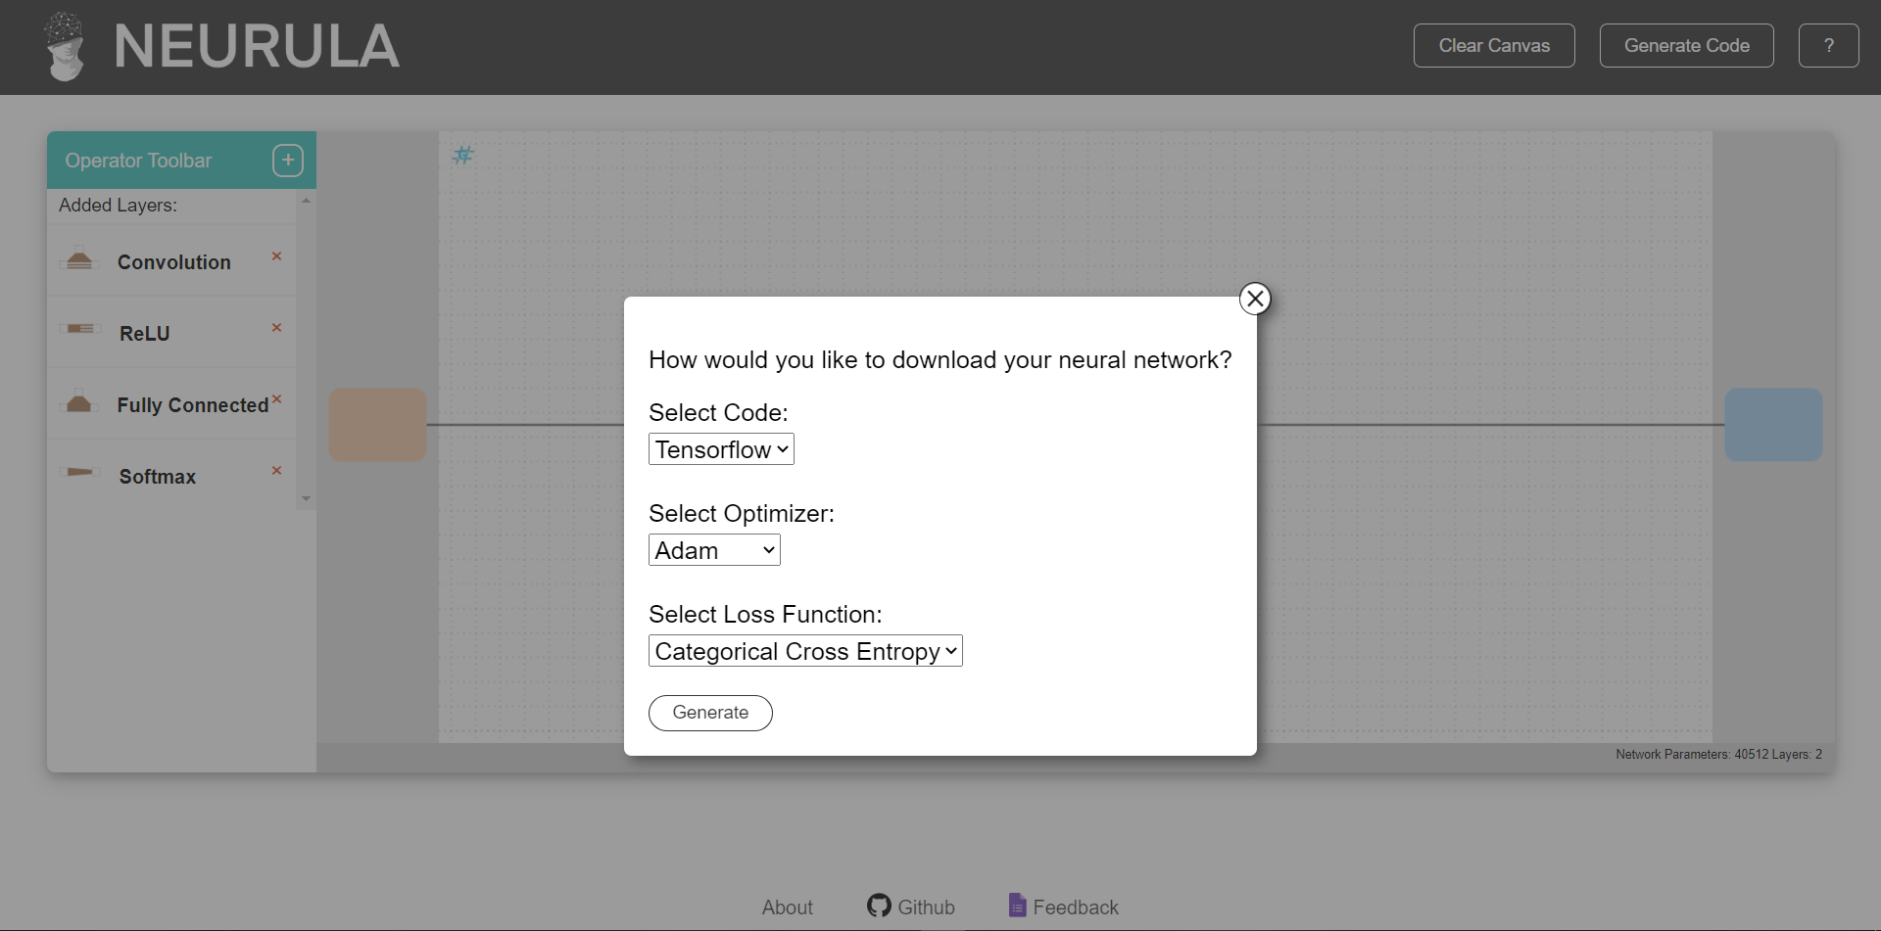

Slide 22
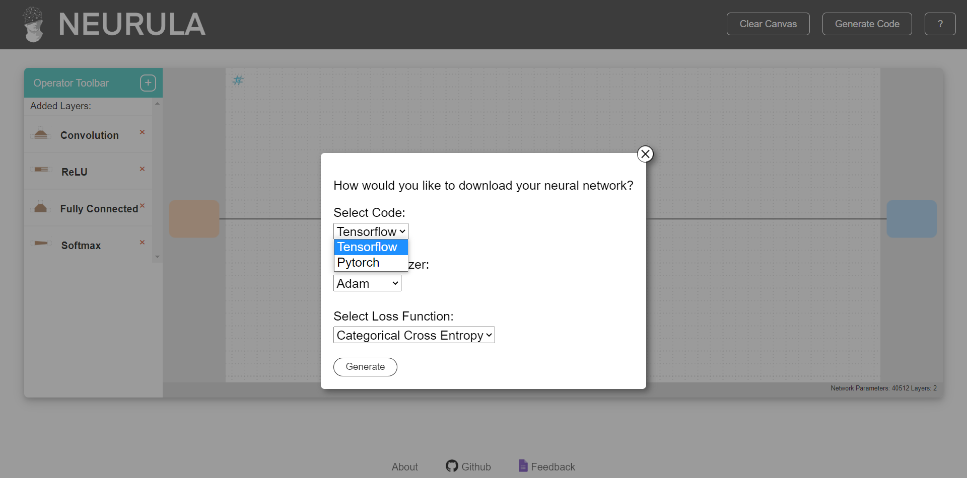

Slide 23
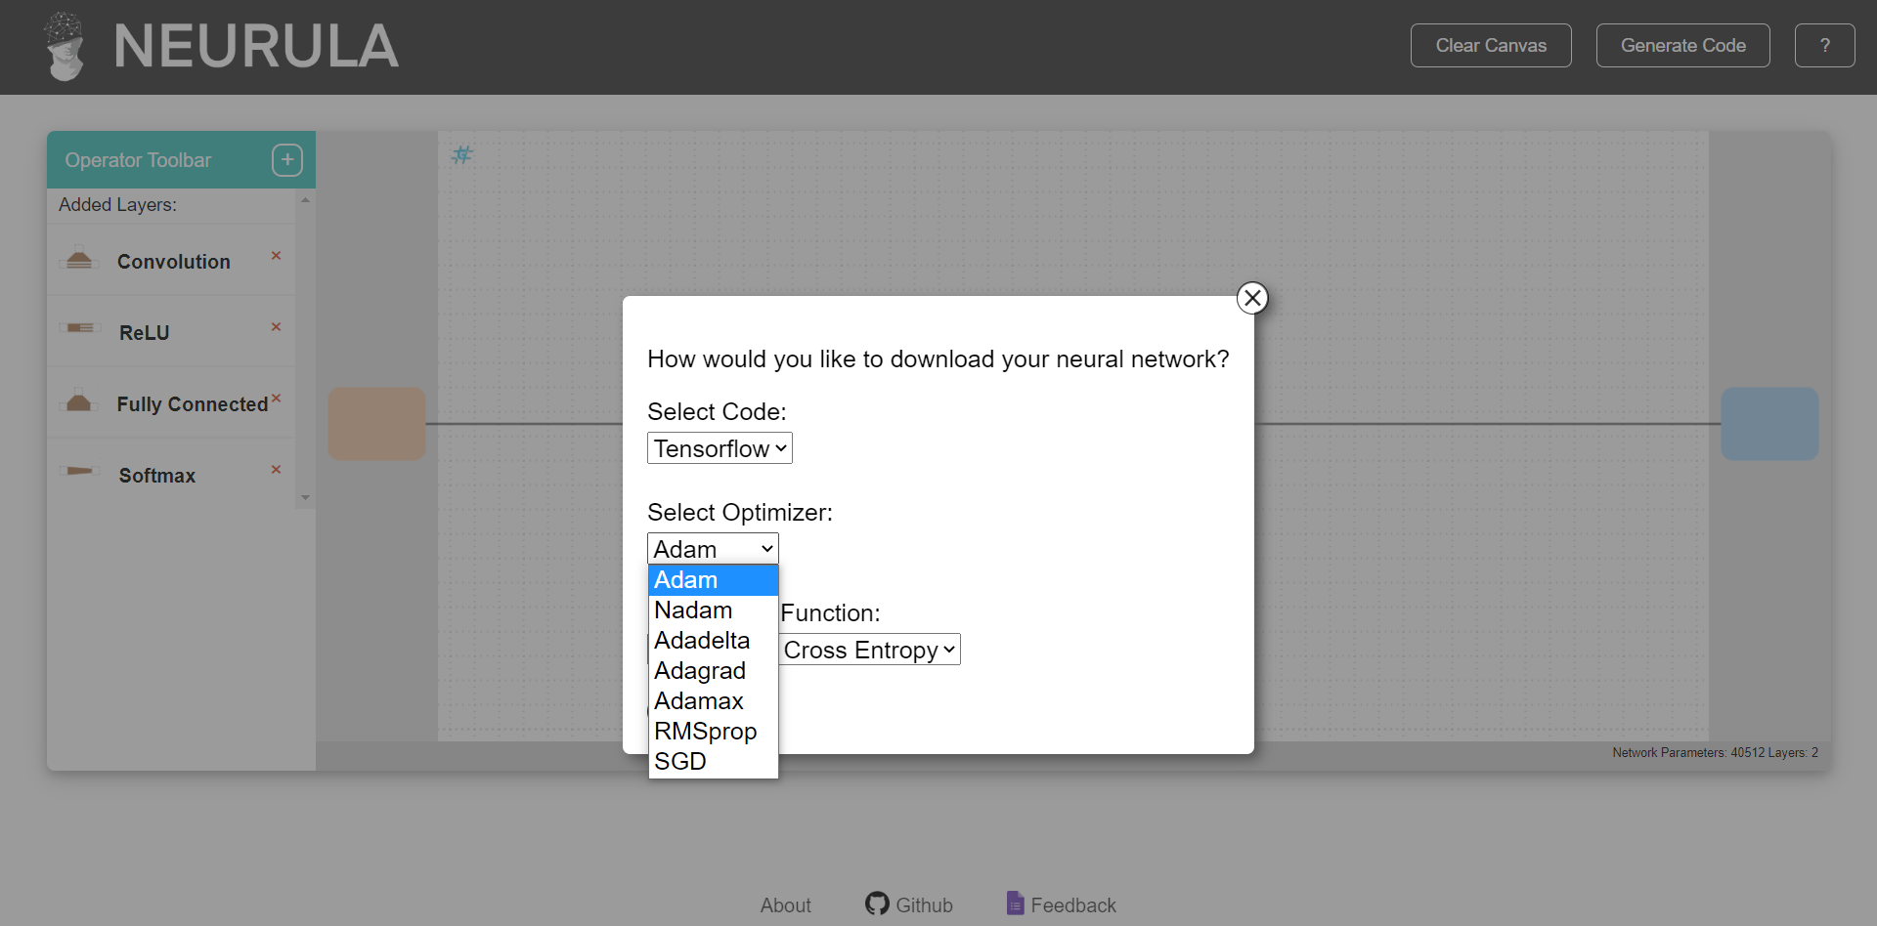

Slide 24
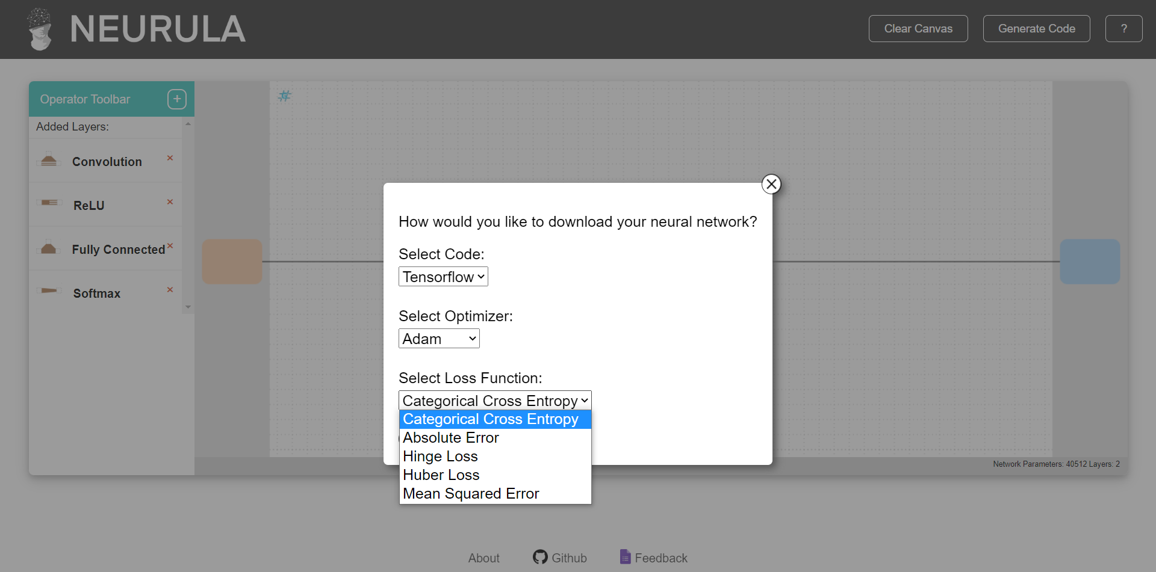

Slide 25
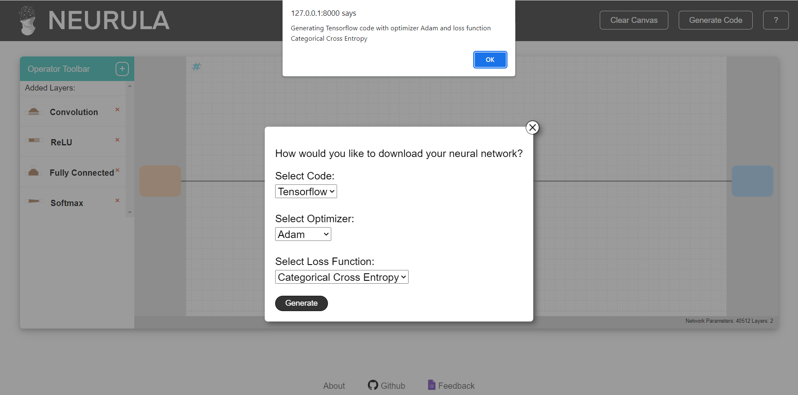

Slide 26
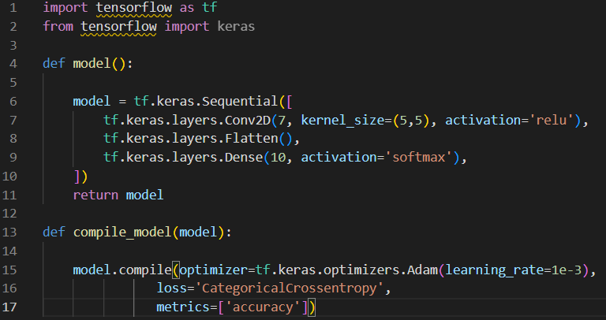

Slide 27
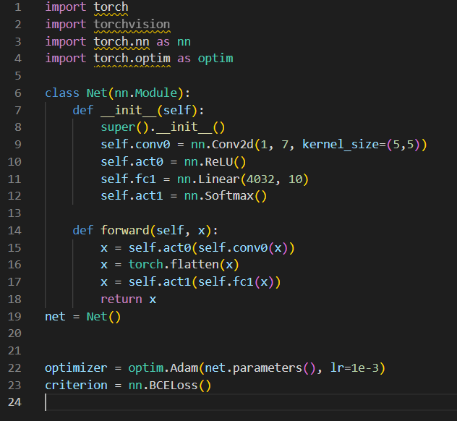

Slide 28
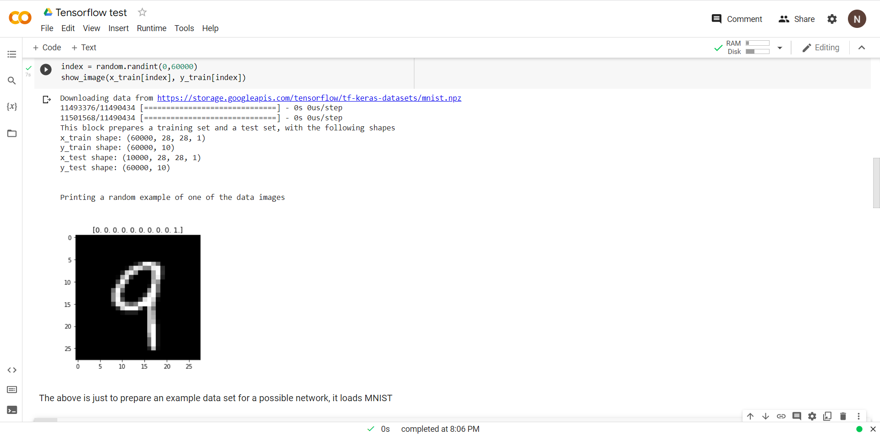

Slide 29
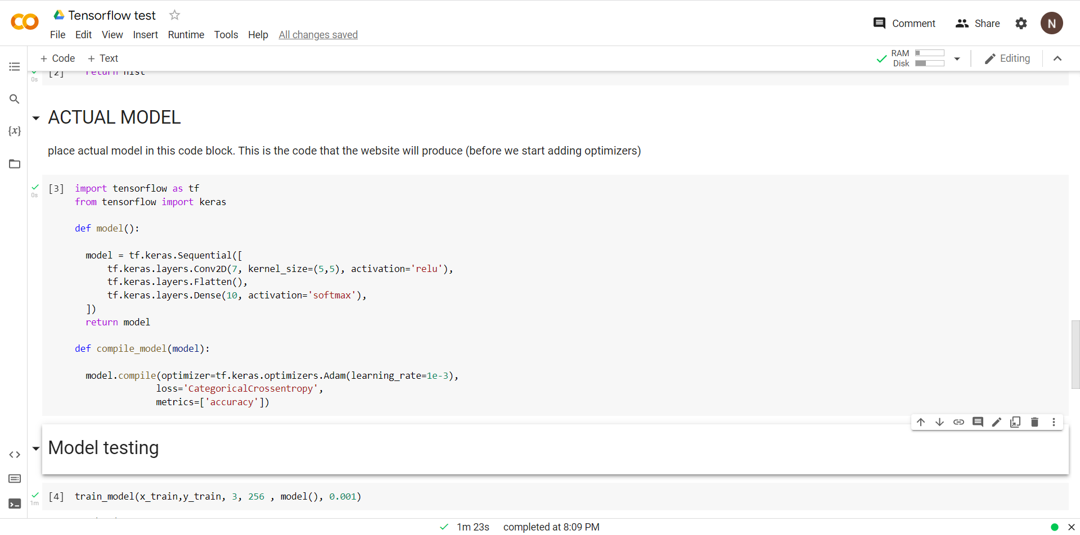

Slide 30
